Slide 1


BUS Presentation On
Prepared by:
Antor Hawlader
ID: 222071024
Dept: CSE
Batch: 30th
8th Semester
Submit On: 31-07-2025
Submitted to:
Donald Rony Gomes, Lecturer,
Department of BBA SMUCT
Shanto Mariam University of Creative Technology
Department: CSE
Course Code: BUS-3309
Course Name: Business Communication

Slide 2
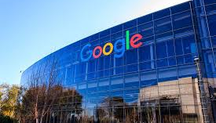
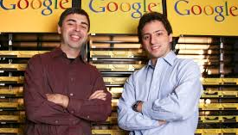
Introduction to Google
Google is a multinational technology company founded in 1998 by Larry Page and Sergey Brin.
Originally started as a search engine, it now operates under its parent company Alphabet Inc.
Its mission: “To organize the world’s information and make it universally accessible and useful.”
Headquartered in Mountain View, California (known as the “Googleplex”).

Slide 3
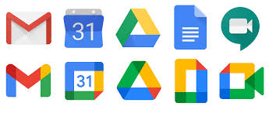
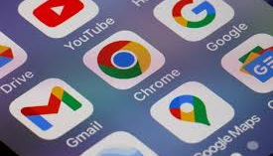
Key Products and Platforms
Google Search – The most widely used search engine in the world.
Gmail – One of the most popular email services.
YouTube – World’s largest video-sharing platform.
Google Maps – Navigation, traffic data, and satellite imagery.
Android OS – Powers over 70% of smartphones globally.
Google Chrome – A dominant web browser with over 60% market share.

Slide 4
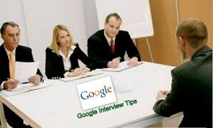
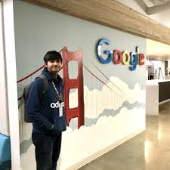
Interview Insights – Bangladesh
Interviewee: Zulkarnine Mahmud (Software Engineer, Bangladesh)
Proved that getting into Google from Bangladesh is possible with smart preparation.
Emphasis during the interview was on problem-solving approach and how clearly candidates explain their logic.
Faced Challenges:
Live coding during video interviews was stressful.
Explaining ideas clearly in real-time took practice.
Suggestion: Improve communication skills along with technical preparation.

Slide 5
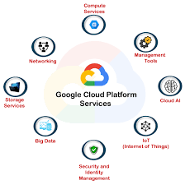
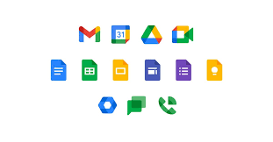
Google Cloud & Enterprise Services
Google Cloud Platform (GCP) offers cloud computing, machine learning, and data storage.
Trusted by major companies for scalability, security, and AI services.
Google Workspace includes tools like Google Docs, Sheets, Meet, and Calendar.
Competes with Microsoft Office 365 and Amazon Web Services (AWS).

Slide 6
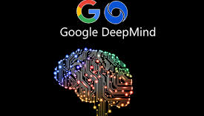
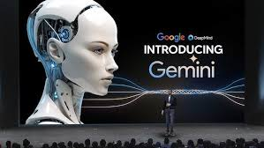
Artificial Intelligence Leadership
Google leads global AI development through projects like:
Gemini (formerly Bard) – Conversational AI system.
DeepMind – Advanced AI research for science, healthcare, and robotics.
AI-powered features in Gmail, Google Photos, and Docs (e.g., Smart Compose, Magic Editor).
Focus areas: natural language processing, generative AI, image recognition, and translation.

Slide 7
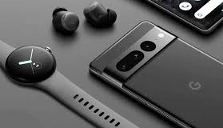
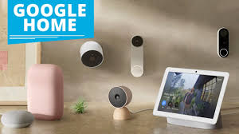
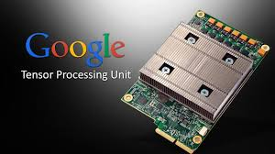
Hardware Innovations
Pixel Devices – Premium smartphones and tablets designed by Google.
Nest Products – Smart home gadgets like thermostats, doorbells, and speakers.
Tensor Processing Units (TPUs) – Custom AI chips developed for advanced computing.
Google’s hardware ecosystem is growing to compete with Apple and Samsung.

Slide 8
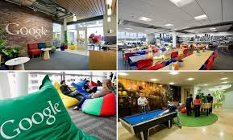
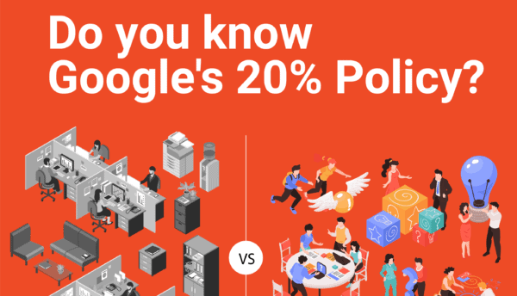
Google’s Work Culture
Google is known for its innovative and employee-friendly work environment.
Core values: “Googliness”, diversity, open communication, and experimentation.
Unique perks: free meals, on-campus gyms, flexible work hours, creative freedom.
Encourages innovation through “20% time” — employees can work on side projects.

Slide 9
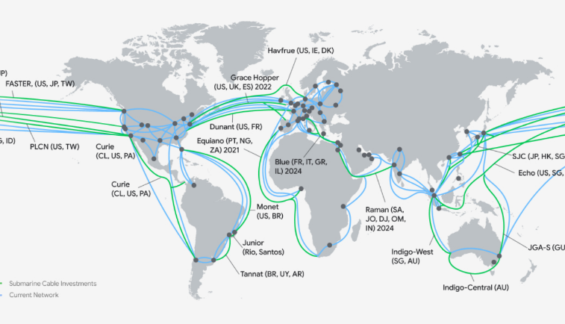

Global Reach & Impact
Operates in over 100 countries and supports over 5 billion daily users.
Strong presence in digital education, healthcare, finance, and communication.
Programs like Google for Startups, Google for Education, and Grow with Google help empower communities.
Major influence on global digital transformation and information access.

Slide 10


Google’s Future Plans
AI First Strategy: Invest heavily in artificial general intelligence (AGI), large language models, and ethical AI.
Quantum Computing: Building quantum processors for future breakthroughs in science.
Sustainability Goals: Carbon-free energy for all data centers by 2030.
Cybersecurity Expansion: More secure platforms across Android and Chrome.
New Frontiers: AI in healthcare, self-driving technology (Waymo), and augmented reality.

Slide 11
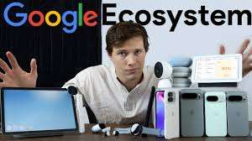
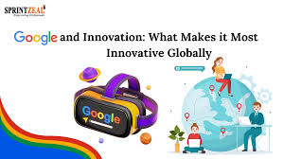
Conclusion
Google is no longer just a search engine — it is a technology ecosystem.
Dominates in search, cloud, mobile OS, and AI innovation.
Known for its strong culture of innovation, diversity, and impact.
Future focus: Making the digital world smarter, safer, and more sustainable for everyone.
Google continues to shape the future of how we work, learn, and live.

Slide 12
THANK YOU

